Slide 1


Slide 2

Jacobs Early Career Development: We Want You to Dream Big
https://www.youtube.com/watch?v=4yN5cj-mMQc

Slide 3
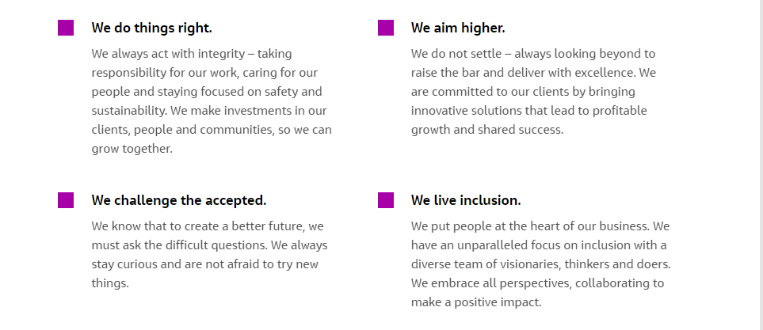
Life at Jacobs
You have purpose. And at Jacobs, you can live it. No matter what drives you, you’ll discover how you can cultivate, nurture and achieve your goals all at a single global company.​

Slide 4

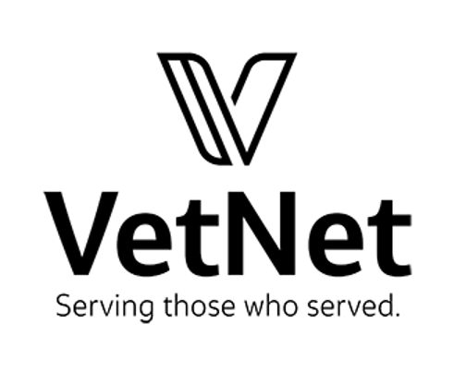


We Live Inclusion
At Jacobs, inclusion powers our collective strength. We believe our differences can broaden perspectives, our connections build confidence, and our collaboration inspires growth.
As part of our Culture of Caring, we unite employees across the globe to foster these differences and amplify each voice through our employee networks. Discover the employee led and employee organized groups that speak to you. Together, we accomplish more than we ever could alone.

Slide 5
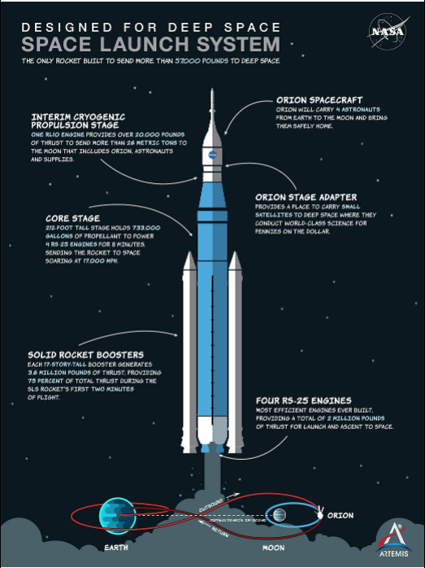
You Could be Working on the Space Launch
Systems (SLS)
Powered by four RS-25 engines and twin solid rocket boosters, NASA’s Space Launch System (SLS) rocket produces 8.8 million pounds of thrust to propel the agency’s Artemis missions to the Moon.
Offering more payload mass, volume capability and energy to speed missions through deep space, the SLS rocket is designed to be both flexible and evolvable to enable a variety of missions, including landing the first woman and the next man on the Moon by 2024.
SLS, along with NASA’s Gateway in lunar orbit and the Orion spacecraft, is NASA’s backbone for NASA’s deep space exploration. It is the only rocket that can send Orion, astronauts and supplies beyond Earth’s orbit to the Moon on a single mission.

Slide 6
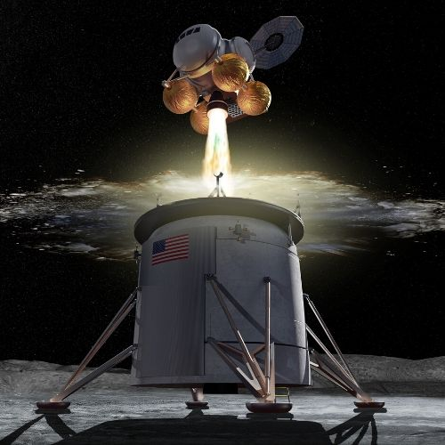
Or Human Landing Systems (HLS)
HLS features offer support for lunar surface extra-vehicle activities (EVA) and global lunar surface access
The HLS will meet scientific requirements for lunar discovery and exploration by offering favorable vantage point for Earth, sun and deep space observations
The HLS will prove technologies that enable Lunar missions and feed forward to Mars and other deep space destinations.

Slide 7
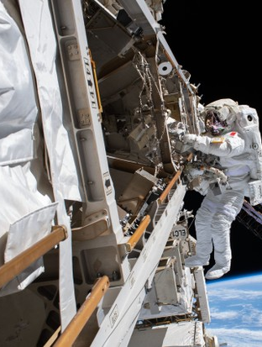
Or Even the International Space Station (ISS)
The station serves as a microgravity and space environment research laboratory in which scientific research is conducted in astrobiology, astronomy, meteorology, physics, and other fields.
The ISS is suited for testing the spacecraft systems and equipment required for possible future long-duration missions to the Moon and Mars
The ISS provides a platform to conduct scientific research, with power, data, cooling, and crew available to support experiments. Small uncrewed spacecraft can also provide platforms for experiments, especially those involving zero gravity and exposure to space, but space stations offer a long-term environment where studies can be performed potentially for decades, combined with ready access by human researchers

Slide 8
What Your Degree Can Do for You
Aeronautical/Aerospace Engineer: design, development, construction, testing, and operation of vehicles operating in the Earth’s atmosphere or in outer space
Data Process/Analyst Engineer: supercomputer simulations that can help conduct research with less time and expense. Engineers are needed to process the data collected in these simulations and determine how to use it to deploy new solutions
Design Engineer: work on products and systems that involve adapting and using complex scientific and mathematical techniques. The emphasis tends to be on utilizing engineering physics and sciences to develop solutions
Electrical Engineer: determine the risks due to solar storms to the shuttle, International Space Station and crews, and make recommendations that would ensure the safety of the shuttle, ISS and crews.
Hardware Engineer: design, build, and test the latest computer and electronics hardware
Instrumentation Engineer: measuring instruments that are used for indicating, measuring and recording physical quantities such as flow, temperature, level, distance, angle, or pressure
Mechanical Engineer: design and research potential advances, whether they are large engines or tiny sensors, to develop new and better aerospace technologies for current and future needs
Payload Specialist: help with data collection, experimentation, and other work critical to a space mission. Payload specialists accompany a piece of equipment in order to properly install or use it in the mission
Software Engineer: design, develop and maintain software systems including operating systems, business applications, mobile and web applications, connected hardware devices, networking systems
Systems Engineer: focuses on how to design and manage complex systems over their life cycles

Slide 9
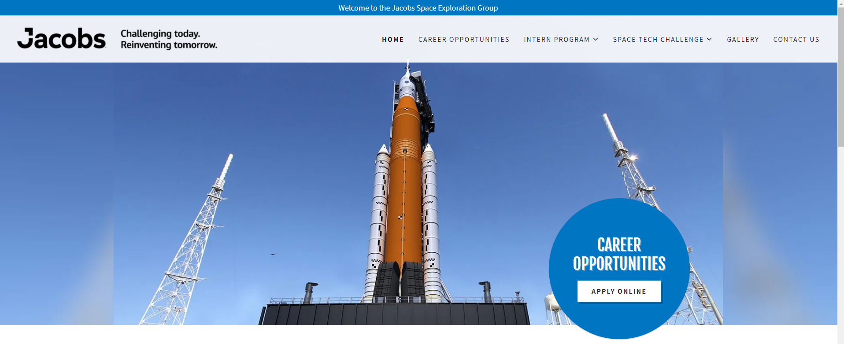
Create a Candidate Profile and Apply
Apply online at https://jseg.space/
Select Sign In to create profile
Select Accept Agreement
Select New User
Create username and password
Remember to select the option to receive job alerts

